Slide 1

Python Basics
Reza Dibaj

Slide 2
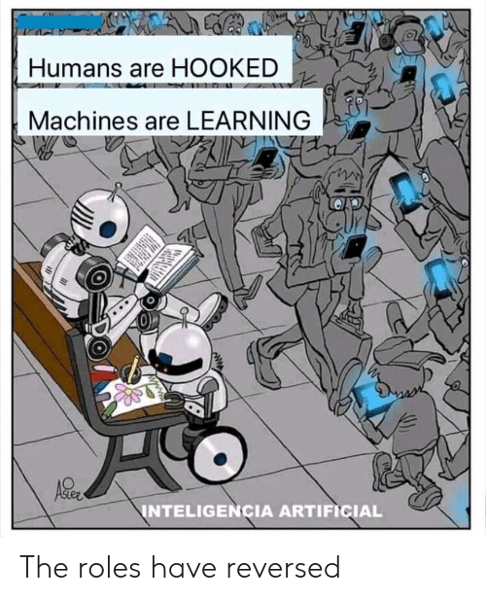

Slide 3
Why we study…
We need motivation for what we do.… for what we learn….
https://www.youtube.com/watch?v=0r1LTe5KkSA

Slide 4


Team Making and Project Definition
We find our team members in one week and define our project in two weeks…

Slide 5

Now, it is your turn…
Please let me know what you think.
As a coach, how can I be any help.
Notes:
Finding our own goals and projects…
Learning Python to the fullest…

Slide 6
This course is not about ….
General Purpose AI
Pure Big Data Concept
Cloud Computing

Slide 7

Quick Review of Whole IT in One Slide
Operating Systems
System S/W
Utilities
Software
Languages
Super High Level
Applications
High Level
Computer
Middle Level
Low Level
Hardware

Slide 8

Group Discussion
Please discuss with your friends why Python?

Slide 9
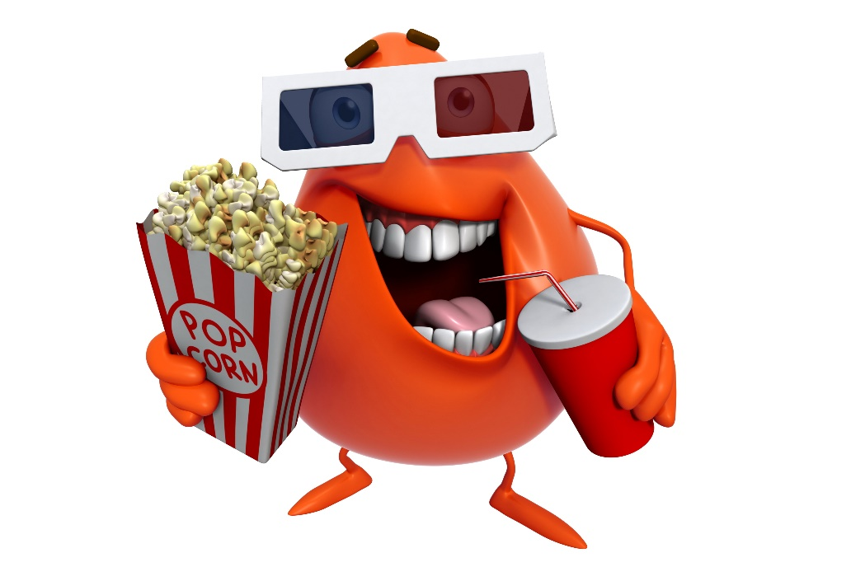
What is Data Science?
Movie time… YAY! ……
Why Python?

Slide 10
What is Data Science?
Movie time… YAY!
Data Science In 5 Minutes

Slide 11

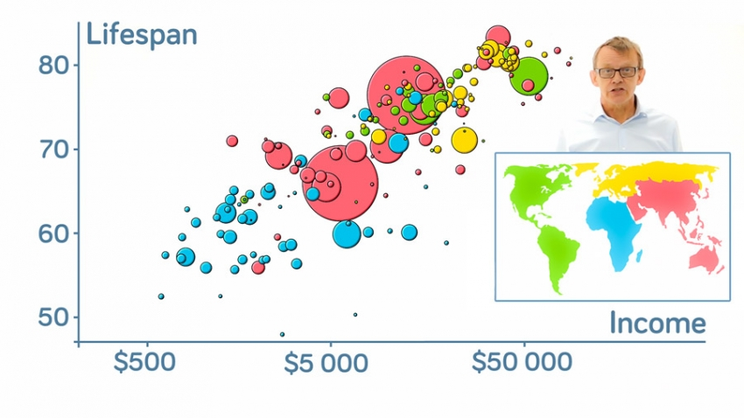
What is Visualization?
Amazing example… Let’s enjoy!
Hans Rosling's 200 Countries, 200 Years, 4 Minutes
“Let my dataset change your mindset.” -Hans Rosling

Slide 12
Important Notes on Python
Online Jupyter:
https://jupyter.org/try
On of the best quickest recap videos which was mentioned in the python official web site:
https://www.youtube.com/watch?v=_uQrJ0TkZlc

Slide 13
Suggested Movies
Hello World Canada: The Rise of AI
The Imitation Game (2014)
2001: A Space Odyssey (1968)
Modern Times by Charlie Chaplin (1936)
The Great Dictator by Charlie Chaplin (1940)

Slide 14

Thank you
Question?
To be
Not to be

